Slide 1

Project Management
Buffalo State Data Science and Analytics
Project Execution Frameworks

Slide 2
What is Agile?
It is a project management paradigm that satisfies the customer through early and continuous delivery.
It uses the idea of delivering a big project in smaller chunks by breaking it up into easily manageable subprojects called “sprints”.
Each sprint contains a finite set of tasks called “user stories”.
The goal of each sprint is to have a complete and well-tested deliverable before moving on to the next sprint.
As the project evolves, the sprints build on each other to eventually deliver a fully functional product or service.

Slide 3
What is Agile?
Let's image this blue arrow is a project
In Agile we will split this project into sprints
Sprint 1
Sprint 2
Sprint 3
Sprint 4
Each sprint will be composed of tasks called "user stories"
User story
User story
User story
User story
User story
User story
User story
User story
User story
User story
User story
User story

Slide 4
Why it is Important?
Often projects get too complicated to plan all at once.
Customers want to see what they are paying for as soon as possible.
Agile allows one to break up a complicated project into small easily manageable parts through sprints.

Slide 5
Agile Frameworks
Scrum
Kanban
Scrumban

Slide 6
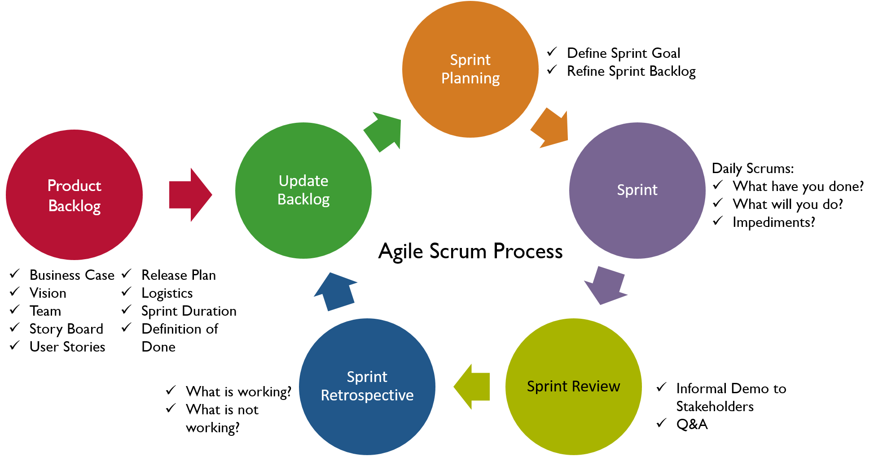
Scrum

Slide 7
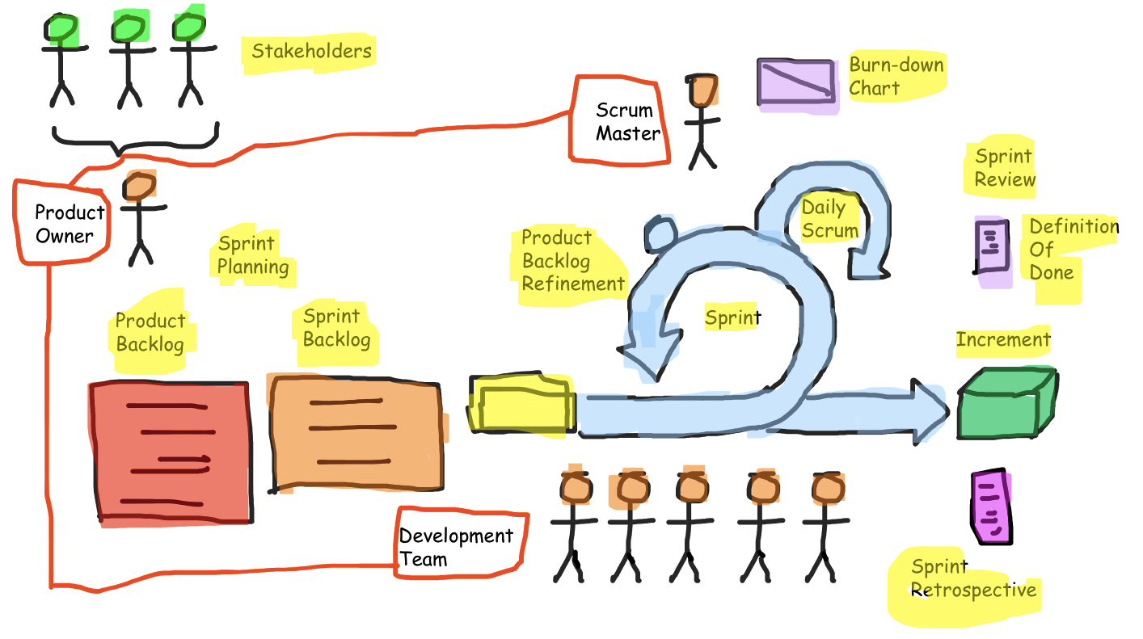
Scrum Roles

Slide 8
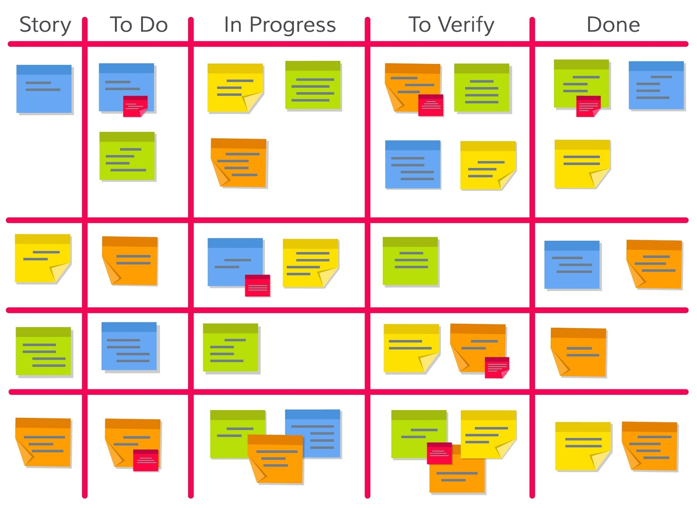
Scrum Board

Slide 9
Kanban
This framework is based on continuous workflow.
There are no sprint planning meetings.
Product owner maintains a small subset of high priority stories which then is handed down to the project team.
Reviews are done when a task is ready for delivery.
Daily stand-up meetings are held to discuss the action items, blockers, and what's next in the backlog to keep everyone on task and engaged.
Kanban board is used to monitor workflows.

Slide 10
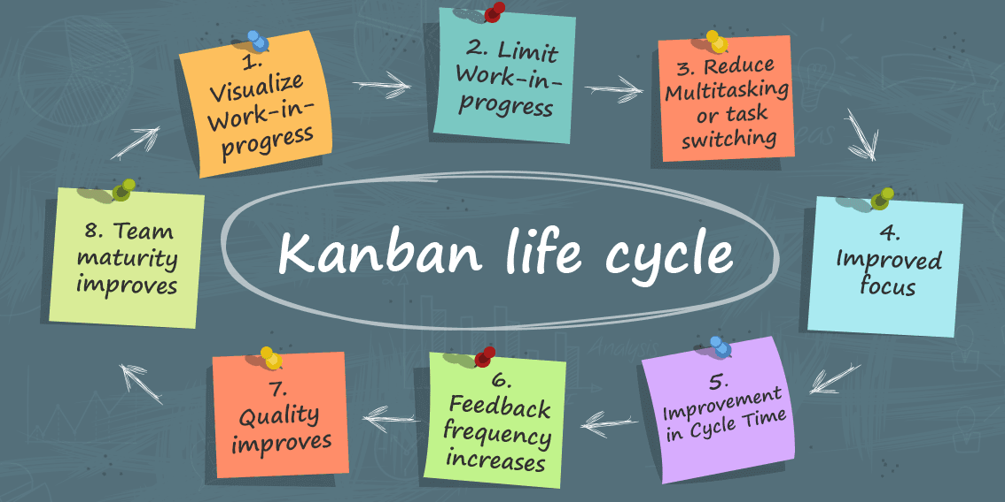
Kanban Life Cycle

Slide 11
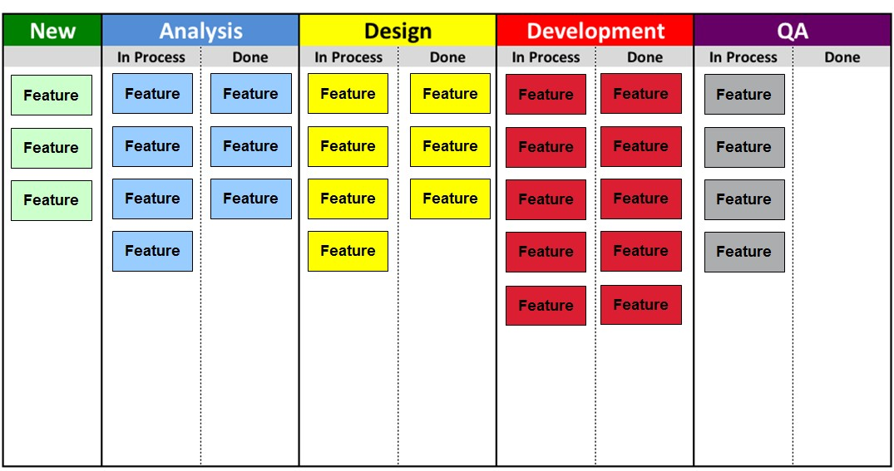
Kanban Board

Slide 12
Scrumban
All sprints have fixed length.
Sprint planning meetings are held at the beginning of each sprint to define user stories for backlog.
Backlog is then maintained throughout the sprint.
Sprint review meetings are held at the end of each sprint to understand what went right and what went wrong.
Daily stand-up meetings are held to discuss the action items, blockers, and what's next in the backlog to keep everyone on task and engaged.
A Kanban board is used to monitor the workflows.

Slide 13
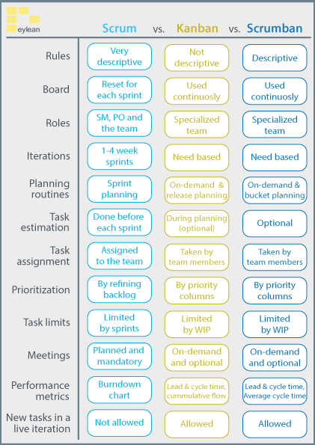
Framework Summary
Acronyms:
SM: Scrum Master
PO: Project Owner
WIP: Work in Progress

Slide 14
Project Execution Tools
Asana
LeanKit
nTask Board
Trello
Kanbanize
Monday.com

Slide 15
Project Execution Tools (Cont.)
ProProfs Project
Hygger
Bitrix24
MeisterTask
Taskworld
Productboard
Swift Kanban

Slide 16
Project Execution Tools (Cont.)
Kanban Tool
Forecast
ProofHub
KanbanFlow
Zoho Projects
Kanbanery

Slide 17
Example 01:
Consider the case of Project LaCEM.
This project followed the Scrum framework for its execution.
The project was broken down into three different sprints
  Sprint 01: Template Development
  Sprint 02: Content Creation
  Sprint 03: Content Review
Each sprint was initiated by a sprint planning meeting where the project team defined the tasks to be completed using a work breakdown structure (WBS) document.
The team held stand-up meetings 2 times a week due to busy schedules.
Additionally, the team met weekly for a professional development session on project management to discuss weekly learning outcomes relating to project management.

Slide 18
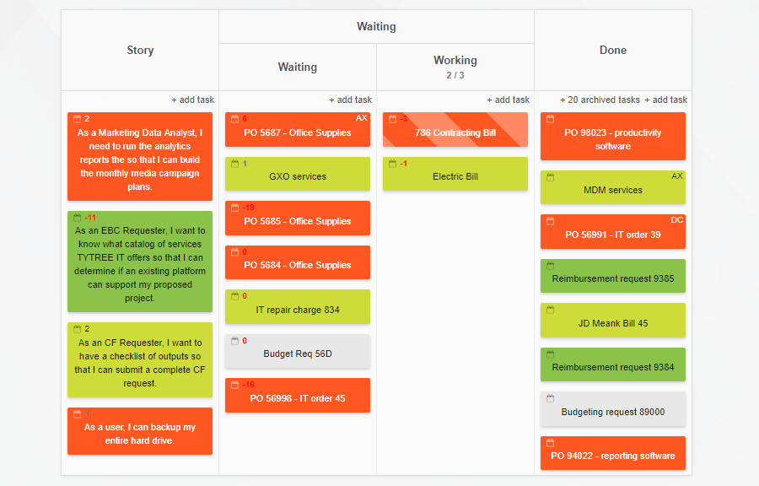
Example 02:
Following is an example of a Kanban Board

Slide 19
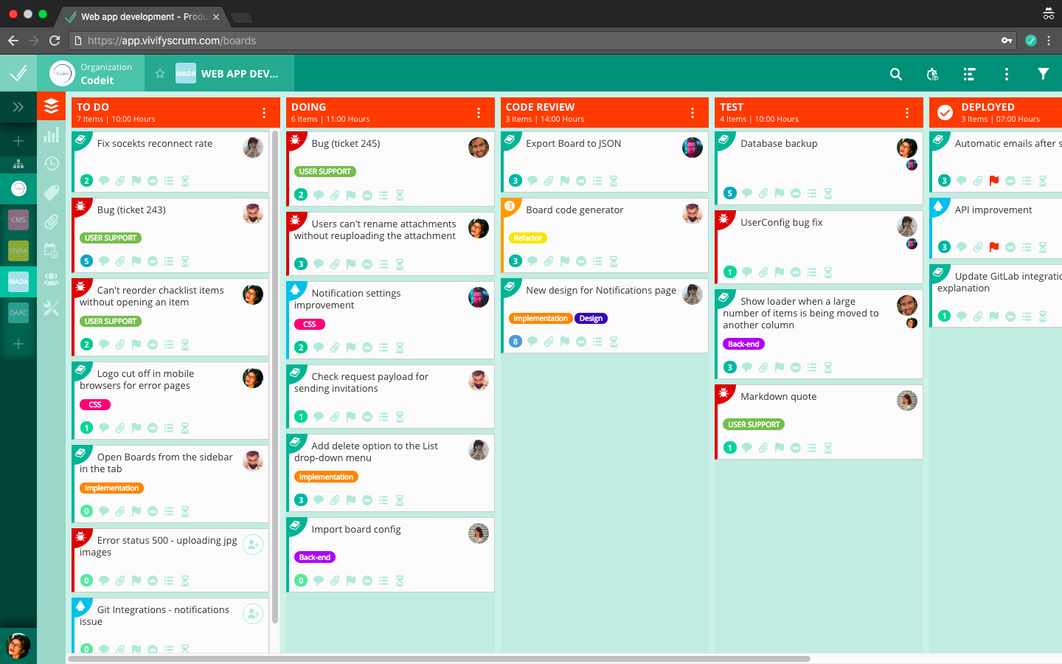
Example 03:
Following is an example of a Kanban Board

Slide 20
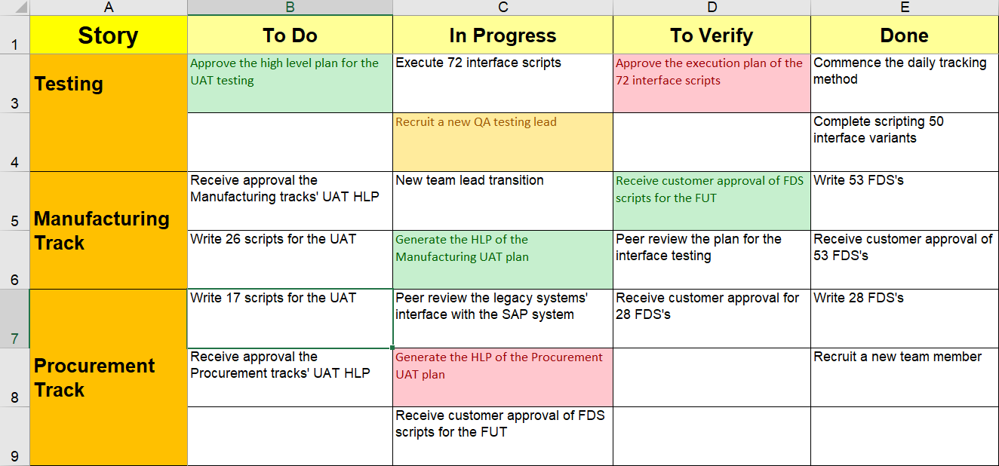
Example 04:
Following is an example of a Kanban Board

Slide 21
References
What is Agile Project Management?
Project Management in Under 5 - YouTube
Agile : Scrum, Kanban & Scrumban
Agile Learning Series: Scrum
18 Best Kanban Tools To Use In 2021

